Slide 1
Chef Q Catering

Slide 2
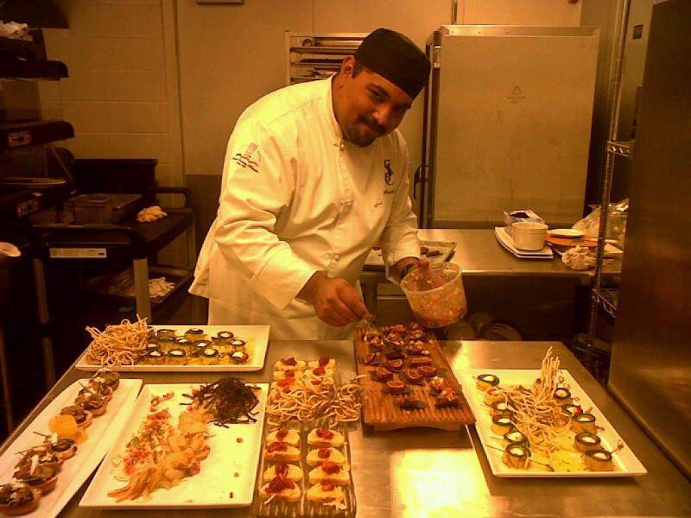

Slide 3
Menu options
Appetizers
Stuffed Jalapeños wrapped in puff pastry.
Pear Quesadillas.
Shrimp al mojo.
Tinga Cazuelitas.
Mozzarella skewers.
Cheese burgers wellington.
Beef /chicken skewers.
Mozzarella wrapped in zucchini
Up to 3 appetizers to chose from this options

Slide 4
Menu options
Main Entrée
Stuffed pork loin poblano pepper.
Smoked pork loin.
Grilled flank steak.
Grilled beef tenderloin.
Smoked brisket.
Smoked salmon.
Vegetarian lasagna.
Chicken parmesan.
Stuffed chicken with mushrooms.
Exotic meats available to season and order. ( venison, fowl, rabbit, quail, kangaroo, turtle.)
Up to 2 main entrée to chose from this options

Slide 5
Menu options
Side orders
Mash potatoes (red, white or sweet potato.)
Rice ( Mexican, white, yellow or wild)
Rosemary potatoes.
Pasta rotini ( Pesto, Alfredo or marinara.)
Grilled vegetables ( Zucchini, eggplant, mushrooms.)
Steam vegetables (carrots, broccoli, coli flour.)
Up to 2 side orders to chose from this options

Slide 6
Menu options
Included on menu
Salad mixed greens or wedge salad
Dressings Ranch, blue cheese, Italian or avocado lime.
Dinner rolls
Fruit plate up to 50 person
Cheese plate up to 50 person
Additional orders are optional.
This items are already included in the menu.

Slide 7
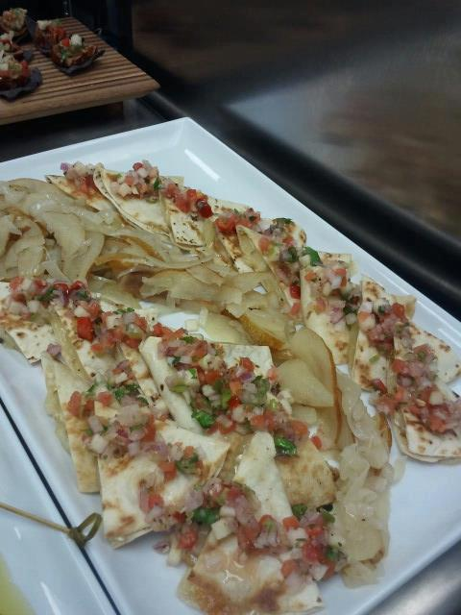
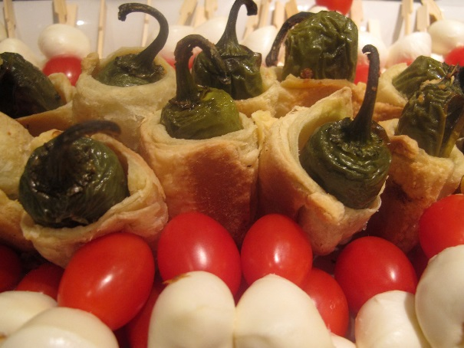
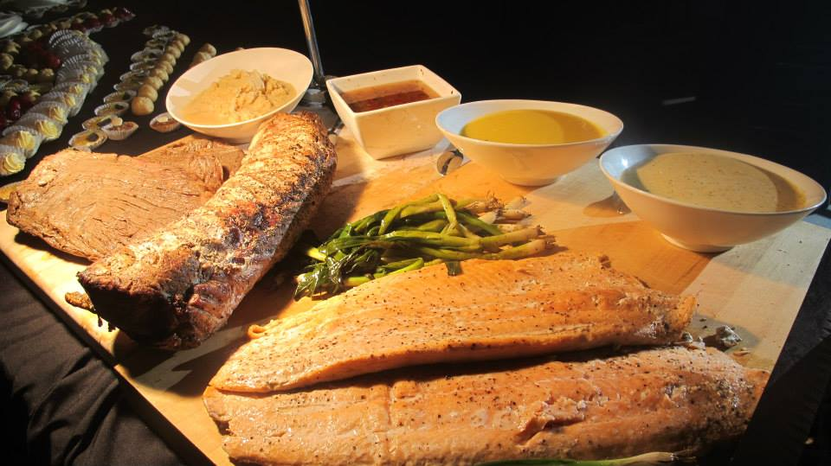
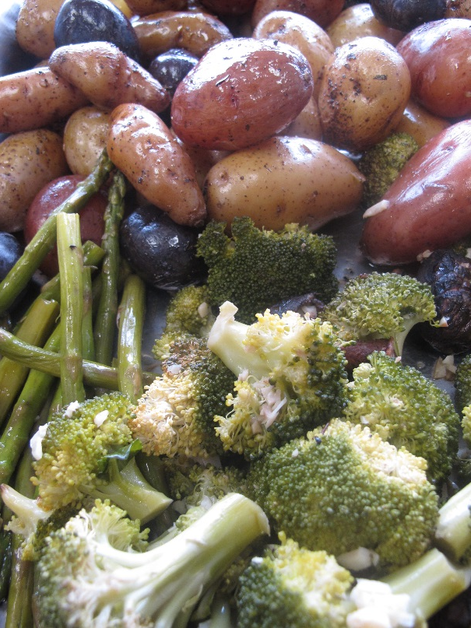
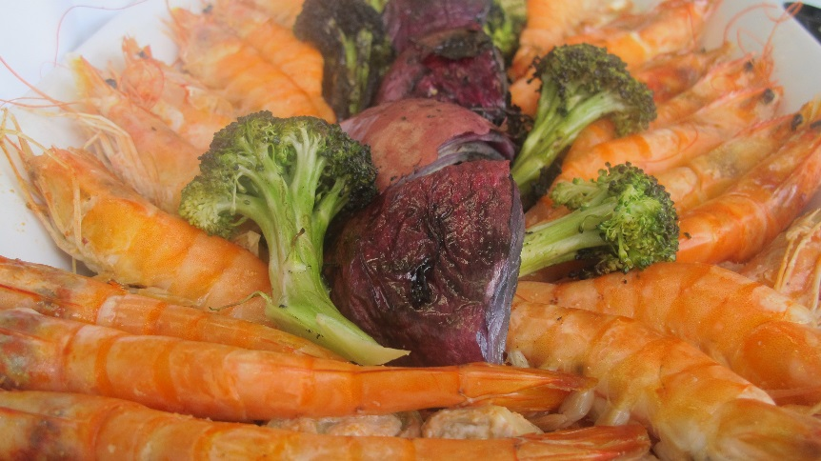

Slide 8
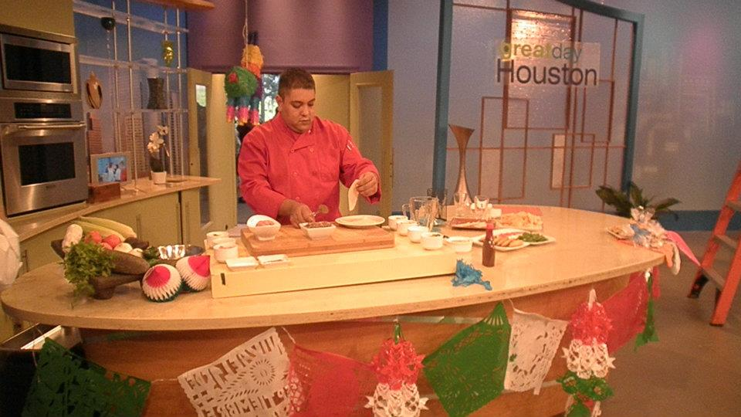
For quotes
832 499 5267
281 258 4923
Jquezadacavazos@Hotmail.com

